Slide 1
Cyclistic Project

Slide 2
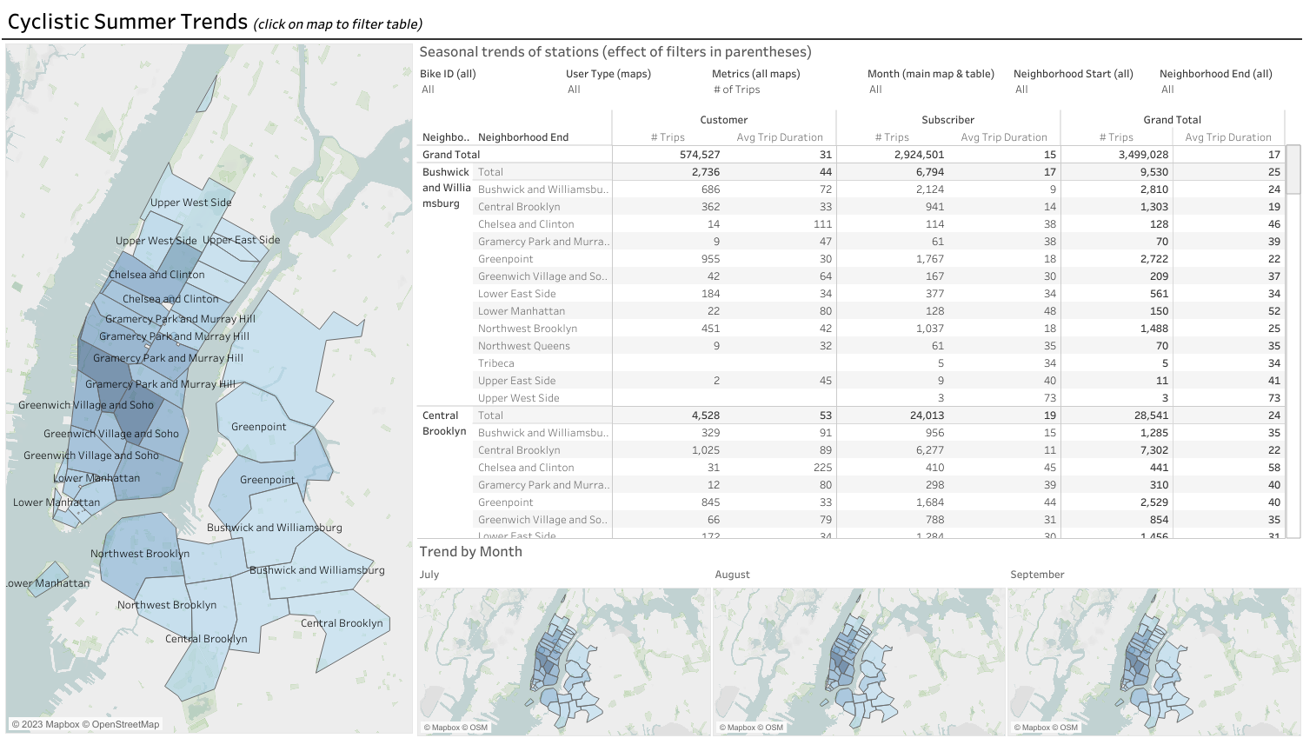

Slide 3
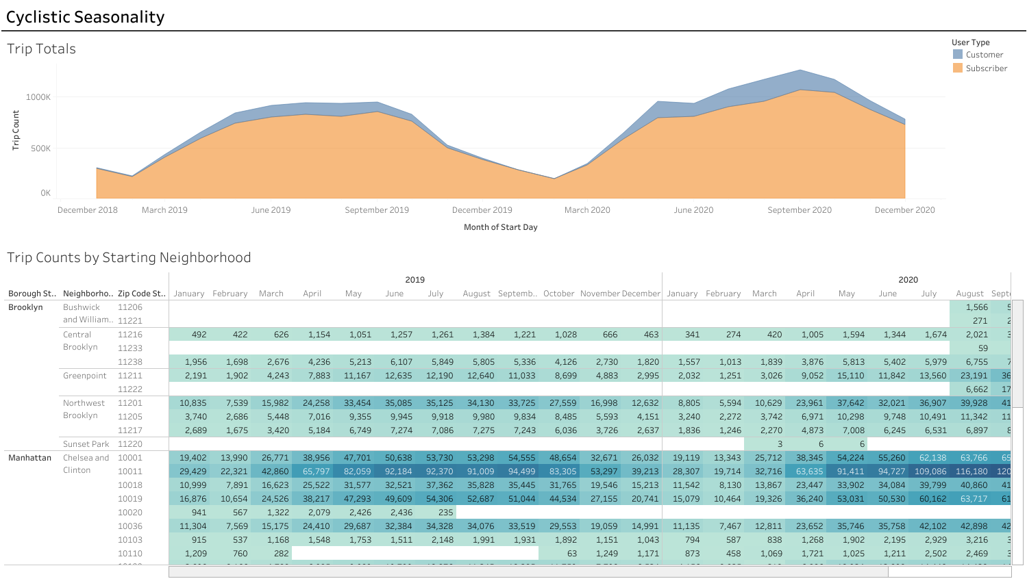

Slide 4
